Slide 1
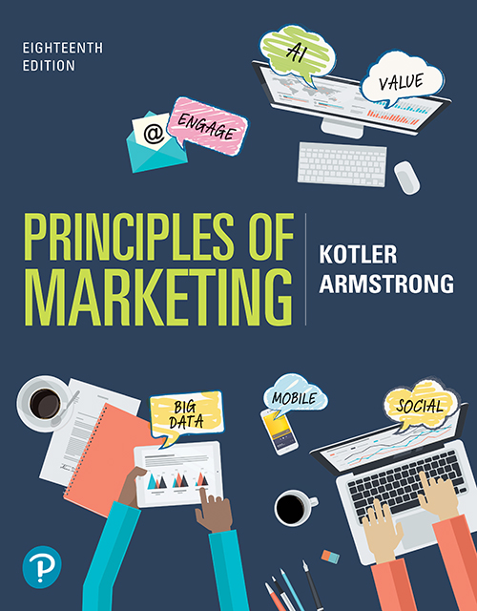
Principles of Marketing
Eighteenth Edition
Chapter 3
Analyzing the Marketing Environment
Copyright © 2021, 2018, 2016 Pearson Education, Inc.
Notes:
If this PowerPoint presentation contains mathematical equations, you may need to check that your computer has the following installed:
1) Math Type Plugin
2) Math Player (free versions available)
3) NVDA Reader (free versions available)

Slide 2
Learning Objectives
3.1 Describe the environmental forces that affect the company’s ability to serve its customers.
3.2 Explain how changes in the demographic and economic environments affect marketing decisions.
3.3 Identify the major trends in the firm’s natural and technological environments.
3.4 Explain the key changes in the political and cultural environments.
3.5 Discuss how companies can react to the marketing environment.

Slide 3

MICROSOFT: Adapting to the Fast-Changing Marketing Environment
“Microsoft has undergone a dramatic transformation to better align itself with the new digital world. More than just making the software that makes PCs run, Microsoft now wants to empower every person and every organization on the planet to achieve more, regardless of what device or operating system they use.”
Notes:
Microsoft dominated the computer software world throughout the 1990s and much of the 2000s. Its Windows and Office products dominate in the PC market, but it struggled to find its place in the fast-changing environment where PCs declined and everything was connected. It reinvented itself as a relevant brand.

Slide 4
A Company’s Marketing Environment
The marketing environment includes the actors and forces outside marketing that affect marketing management’s ability to build and maintain successful relationships with target customers.
Notes:
Marketers must be environmental trend trackers and opportunity seekers.
By carefully studying the environment, marketers can adapt their strategies to meet new marketplace challenges and opportunities.
By using marketing research and marketing intelligence, companies constantly watch and adapt to the changing environment—or like Microsoft, in many cases, lead those changes.

Slide 5
Learning Objective 1
Describe the environmental forces that affect the company’s ability to serve its customers.

Slide 6
The Microenvironment and Macroenvironment (1 of 2)
Microenvironment consists of the actors close to the company that affect its ability to serve its customers—the company, suppliers, marketing intermediaries, customer markets, competitors, and publics.

Slide 7
The Microenvironment and Macroenvironment (2 of 2)
Macroenvironment consists of the larger societal forces that affect the microenvironment—demographic, economic, natural, technological, political, and cultural forces.

Slide 8
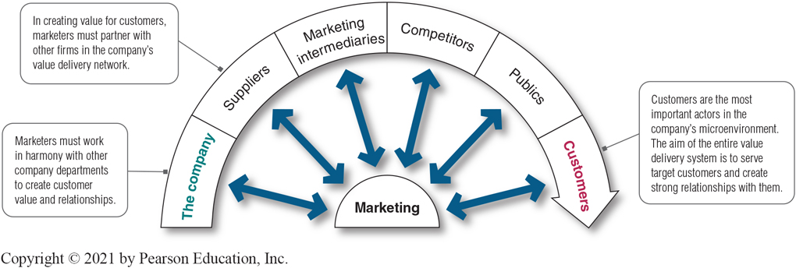
The Microenvironment (1 of 8)
Figure 3.1 Actors in the Microenvironment
Notes:
Marketing management’s job is to build relationships with customers by creating customer value and satisfaction. However, marketing managers cannot do this alone.
Figure 3.1 shows the major actors in the marketer’s microenvironment. Marketing success requires building relationships with other company departments, suppliers, marketing intermediaries, competitors, various publics, and customers, which combine to make up the company’s value delivery network.
Long Description:
The details of the figure are as follows:
Marketing is connected to the following by double-headed arrows:
The company: Marketers must work in harmony with other company departments to create customer value and relationships.
Suppliers: In creating value for customers, marketers must partner with other firms in the company’s value delivery network.
Marketing intermediaries
Competitors
Publics
Customers: Customers are the most important actors in the company’s microenvironment. The aim of the entire value delivery system is to serve target customers and create strong relationships with them.

Slide 9
The Microenvironment (2 of 8)
The Company
In designing marketing plans, marketing management takes other company groups into account.
Top management
Finance
Research and development (R&D)
Information technology
Purchasing
Operations
Human resources
Accounting
Notes:
All of these interrelated company groups form the internal environment, the microenvironment. With marketing taking the lead, all departments—from manufacturing and finance to legal and human resources—share the responsibility for understanding customer needs and creating customer value.
Discussion Questions
What type of collaboration does there need to be between the departments?
How might projects be integrated between marketing and finance?
How might projects be integrated between marketing and information systems?
This question on finance could lead to a discussion about budgeting for marketing. The collaboration between marketing and IS could lead to discussions of market research, ordering systems, and customer relationship management systems.

Slide 10

The Microenvironment (3 of 8)
Suppliers
Provide the resources to produce goods and services
Treat as partners to provide customer value
Suppliers: Giant furniture retailer IKEA doesn’t just buy from its suppliers. It involves them deeply in the process of delivering the trendy but simple and affordable home furnishings to create a better everyday life for its customers.
Notes:
Suppliers form an important link in the company’s overall customer value delivery network. Supplier problems can seriously affect marketing.
Marketing managers must watch supply availability and costs. Supply shortages or delays, labor strikes, natural disasters, and other events can cost sales in the short run and damage customer satisfaction in the long run. Rising supply costs may force price increases that can harm the company’s sales volume.
IKEA, the world’s largest furniture retailer, relies on about 1,000 suppliers in 51 countries to stock its shelves. That number might have to double in the next decade if it continues its current rate of growth.

Slide 11

The Microenvironment (4 of 8)
Marketing Intermediaries
Partnering with intermediaries: Coca-Cola provides its retail partners with much more than just soft drinks. It also pledges powerful marketing support.
Marketing intermediaries are firms that help the company to promote, sell, and distribute its goods to final buyers.
Notes:
Marketing intermediaries help the company promote, sell, and distribute its products to final buyers. They include resellers, physical distribution firms, marketing services agencies, and financial intermediaries.
The text explains how Coke delivers value for their marketing intermediaries:
They understand each retailer partner’s business.
The conduct consumer research and share with partners.
They develop marketing programs and merchandising for partners.

Slide 12
The Microenvironment (5 of 8)
Marketing Intermediaries
Resellers
Physical distribution firms
Marketing services agencies
Financial intermediaries
Notes:
Resellers are distribution channel firms that help the company find customers or make sales to them.
Physical distribution firms help the company stock and move goods from their points of origin to their destinations.
Marketing services agencies are the marketing research firms, advertising agencies, media firms, and marketing consulting firms that help the company target and promote its products to the right markets.
Financial intermediaries include banks, credit companies, insurance companies, and other businesses that help finance transactions or insure against the risks associated with the buying and selling of goods.
Like suppliers, marketing intermediaries form an important component of the company’s overall value delivery network, and marketers recognize the importance of working with their intermediaries as partners rather than simply as channels through which they sell their products.

Slide 13
The Microenvironment (6 of 8)
Competitors
Firms must gain strategic advantage by positioning their offerings strongly against competitors’ offerings in the minds of consumers.
Notes:
Students should note that the competition is just a click away with online purchasing.
The marketing concept states that, to be successful, a company must provide greater customer value and satisfaction than its competitors do.
Marketers must gain strategic advantage by positioning their offerings strongly against competitors’ offerings in the minds of consumers.
No single competitive marketing strategy is best for all companies. Each firm should consider its own size and industry position compared to those of its competitors.

Slide 14
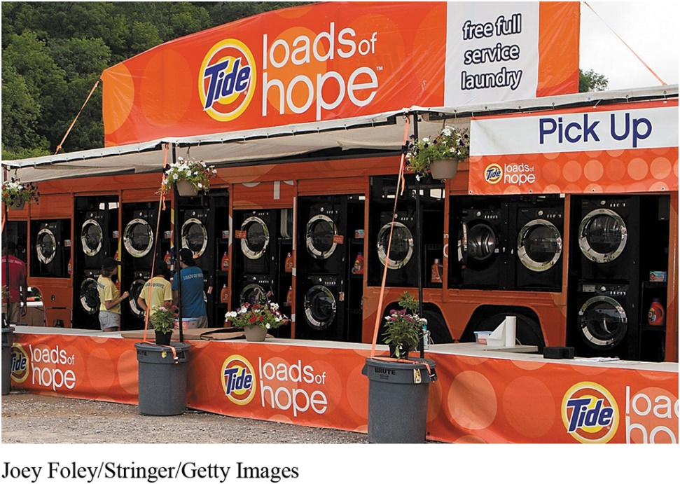
The Microenvironment (7 of 8)
Publics
Publics: P&G has a long history of giving back to its local publics. The Tide Loads of Hope program brings “hope not just soap” in the form of free mobile laundry services to people in communities facing natural disasters.
Any group that has an actual or potential interest in or impact on an organization’s ability to achieve its objectives
Financial publics
Media publics
Government publics
Citizen-action publics
Local publics
General public
Internal publics
Notes:
Financial publics. This group influences the company’s ability to obtain funds.
Media publics. This group carries news, features, and editorial opinion.
Government publics. Management must take government developments into account.
Citizen-action publics. A company’s marketing decisions may be questioned by consumer organizations, environmental groups, minority groups, and others.
Local publics. This group includes neighborhood residents and community organizations.
General public. A company needs to be concerned about the general public’s attitude toward its products and activities.
Internal publics. This group includes workers, managers, volunteers, and the board of directors.
A company can prepare marketing plans for these major publics as well as for its customer markets. The company would have to design offers to these publics that are attractive enough to produce the desired response.

Slide 15
The Microenvironment (8 of 8)
Customers
Consumer markets
Business markets
Reseller markets
Government markets
International markets
Notes:
Consumer markets consist of individuals.
Business markets buy goods and services for further processing or use in their production processes.
Reseller markets buy goods and services to resell at a profit.
Government markets consist of government agencies that buy goods and services to produce public services or transfer the goods and services to others who need them.
International markets consist of various buyers in other countries, including consumers, producers, resellers, and governments.
Each market type has special characteristics that call for careful study by the seller.

Slide 16
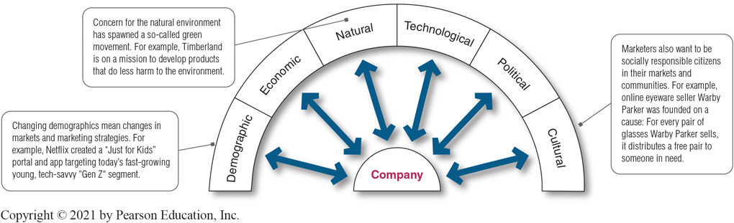
The Macroenvironment
Figure 3.2 Major Forces in the Company’s Macroenvironment
Notes:
As shown in Figure 3.2, the company and all of the other actors operate in a larger macroenvironment of forces that shape opportunities and pose threats to the company.
Even the most dominant companies can be vulnerable to the often turbulent and changing forces in the marketing environment. Some of these forces are unforeseeable and uncontrollable. Others can be predicted and handled through skillful management.
Companies that understand and adapt well to their environments can thrive. Those that don’t can face difficult times.
Long Description:
The details of the diagram are as follows:
Company is connected to the following by double-headed arrows:
Demographic: Changing demographics mean changes in markets and marketing strategies. For example, Netflix created a "Just for Kids" portal and app targeting today’s fast-growing young, tech-savvy "Gen Z" segment.
Economic
Natural: Concern for the natural environment has spawned a so-called green movement. For example, Timberland is on a mission to develop products that do less harm to the environment.
Technological
Political
Cultural: Marketers also want to be socially responsible citizens in their markets and communities. For example, online eyewear seller Warby Parker was founded on a cause: For every pair of glasses Warby Parker sells, it distributes a free pair to someone in need.

Slide 17
Learning Objective 2
Explain how changes in the demographic and economic environments affect marketing decisions.

Slide 18
The Demographic and Economic Environments (1 of 6)
The Demographic Environment
Demography is the study of human populations—size, density, location, age, gender, race, occupation, and other statistics.
Demographic environment involves people, and people make up markets.
Demographic trends include changing age and family structures, geographic population shifts, educational characteristics, and population diversity.
Notes:
The demographic environment is of major interest to marketers because it involves people, and people make up markets.
Marketers keep a close eye on demographic trends and developments in their markets and analyze changing age and family structures, geographic population shifts, educational characteristics, and population diversity.

Slide 19
The Demographic and Economic Environments (2 of 6)
The Demographic Environment
Baby Boomers – born 1946 to 1964
Generation X – born between 1965 and 1980
Millennials – born between 1981 and 1996
Generation Z – born between 1997 and 2012
Generation Alpha – born after 2012
Notes:
The Baby Boomers. Over the years, the baby boomers have been one of the most powerful forces shaping the marketing environment through every stage of life through which they migrate. They represent 22 percent of the U.S. population but control 42 percent of the spending power.
Generation X. Considerably smaller than the boomer generation that precedes them and the Millennials who follow, the Generation Xers are a sometimes overlooked consumer group. From a marketing standpoint, the Gen Xers are a more skeptical bunch who tend to research products before they consider a purchase and prefer quality to quantity. They are less receptive to overt marketing pitches and more likely to be receptive to irreverent ad pitches that make fun of convention and tradition.
Millennials. The Millennials, or Generation Y, are comfortable with technology; it is a way of life. Millennials seek authenticity. They are frugal, practical, connected, mobile, and impatient.
Generation Z. The GenZers make up important tweens and teens markets who spend an estimated $43 to $143 billion annually of their own money and influence a total of almost $333 billion of family spending. These young consumers also represent tomorrow’s markets—they are now forming brand relationships that will affect their buying well into the future.
Generation Alpha. The largest generational group, Generation Alpha will grow larger than millennials by 2025. This cohort will be the most formally educated, most technology-supplied, and the most globally wealthy.

Slide 20

The Demographic and Economic Environments (3 of 6)
The Demographic Environment
Generational marketing is important in segmenting people by lifestyle or life stage instead of age.
Generational marketing: Baby boomers and millennials are now moving over to make room for younger Generation Alpha.
Notes:
Discussion Question
Do marketers need to create separate products and marketing programs for each generation?
Some experts warn that marketers need to be careful about turning off one generation each time they craft a product or message that appeals effectively to another. Others caution that each generation spans decades of time and many socioeconomic levels.
Thus, marketers need to form more precise age-specific segments within each group. More importantly, defining people by their birth date may be less effective than segmenting them by their lifestyle, life stage, or the common values they seek in the products they buy.

Slide 21

The Demographic and Economic Environments (4 of 6)
The Demographic Environment
The changing American family
Geographic shifts in population
A better-educated, more white-collar, more professional population
Increasing diversity
Working remotely: Apps like Slack let people working remotely collaborate anywhere and everywhere through the internet and mobile devices.
Notes:
Changes in the American family have included fewer married couples; more people divorcing or separating, choosing not to marry, marrying later, remarrying, or marrying without intending to have children; more women work outside the home; more men stay at home with the children and manage the household.
Americans are mobile people, with 10 percent of U.S. residents moving each year. Recently, the U.S. population has shifted from the Snowbelt states to the Sunbelt states. Americans have been moving from rural to metropolitan areas. The telecommuting market is lucrative.
Discussion Questions
Why do you think these geographic shifts in population are happening?
Where will you choose to live when you finish your education? Why?
The workforce is better-educated, more white-collar, and more professional.
Markets are increasingly diverse, which goes beyond ethnic heritage.

Slide 22

The Demographic and Economic Environments (5 of 6)
The Demographic Environment
Targeting consumers with disabilities: Toyota’s “Start Your Impossible” campaign included ads highlighting inspirational real-life stories of athletes who overcame mobility challenges, such Paralympic gold medalist alpine skier Lauren Woolstencroft.
Notes:
How are companies trying to reach consumers with disabilities? Many marketers now recognize that the worlds of people with disabilities and those without disabilities are one in the same.
As the population in the United States grows more diverse, successful marketers will continue to diversify their marketing programs to take advantage of opportunities in fast-growing segments.

Slide 23

The Demographic and Economic Environments (6 of 6)
The Economic Environment
Economic environment: Consumers adopted a new back-to-basics sensibility in their lifestyles and spending patterns. To serve the tastes of these more financially frugal buyers, companies like Target are emphasizing the “pay less” side of their value propositions.
Notes:
You’d expect value pitches from the sellers of everyday products. For example, as Target has shifted emphasis toward the “Pay Less” side of its “Expect More. Pay Less.” slogan, the once-chic headlines at the Target.com website have been replaced by more practical appeals such as “Our lowest prices of the season,” “Slam dunk deals,” and “Free shipping, every day.”

Slide 24
Learning Objective 3
Identify the major trends in the firm’s natural and technological environments.

Slide 25
The Natural and Technological Environments (1 of 4)
The Natural Environment
The natural environment is the physical environment and the natural resources that are needed as inputs by marketers or that are affected by marketing activities.
Notes:
Today’s enlightened companies are developing environmentally sustainable strategies in an effort to create a world economy that the planet can support indefinitely.

Slide 26
The Natural and Technological Environments (2 of 4)
The Natural Environment
Trends in the Natural Environment
Growing shortages of raw materials
Increased pollution
Increased government intervention
Developing strategies that support environmental sustainability
Notes:
Marketers should be aware of several trends in the natural environment.
First, there are growing shortages of raw materials. Air and water may seem to be infinite resources, but some groups see long-run dangers. Renewable resources, such as forests and food, also have to be used wisely. Nonrenewable resources, such as oil, coal, and various minerals, pose a serious problem. Firms making products that require these scarce resources face large cost increases, even if the materials remain available.
A second environmental trend is increased pollution. Industry will almost always damage the quality of the natural environment. Consider the disposal of chemical and nuclear wastes; chemical pollutants in the soil and food supply; and the littering of the environment with non-biodegradable packaging materials.
A third trend is increased government intervention in natural resource management. The governments of different countries vary in their concern and efforts to promote a clean environment. The Environmental Protection Agency (EPA) was created in 1970 to create and enforce pollution standards and conduct pollution research.
Many companies are developing strategies that support environmental sustainability.

Slide 27

The Natural and Technological Environments (3 of 4)
The Natural Environment
The natural environment: Walmart has emerged in recent years as the world’s super “eco-nanny” through its own sustainability practices and its impact on the actions of its huge network of suppliers.
Environmental sustainability involves developing strategies and practices that create a world economy that the planet can support indefinitely.
Notes:
Concern for the natural environment has spawned the so-called green movement and the development of strategies and practices that support environmental sustainability.
Environmental sustainability means meeting present needs without compromising the ability of future generations to meet their needs.
Many companies are responding to consumer demands with more environmentally responsible products. Others are developing recyclable or biodegradable packaging, recycled materials and components, better pollution controls, and more energy-efficient operations.
Companies today are looking to do more than just good deeds. More and more, they are recognizing the link between a healthy ecology and a healthy economy. They are learning that environmentally responsible actions can also be good business.

Slide 28
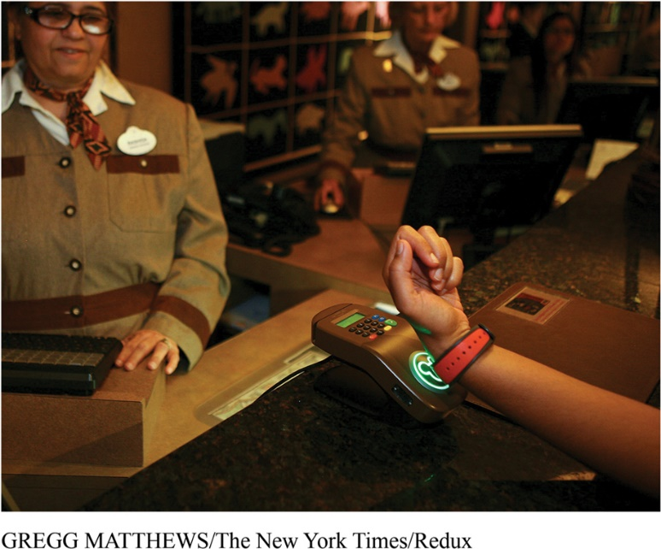
The Natural and Technological Environments (4 of 4)
The Technological Environment
Marketing technology: Disney takes full advantage of digital technology in creating magical customer experiences at its Walt Disney World Resort.
Most dramatic force in changing the marketplace
New products, opportunities
Concern for the safety of new products
Notes:
Discussion Question
Ask students what changes they have seen in technology in the past four years including medical products, communications, and media.
New technologies can offer exciting opportunities for marketers. Digital technologies and the Internet of Things (IoT) have created a brave new world of marketing. Digital has become a part of everything we do as consumers. Companies that do not keep up with technology changes may find their products outdated. The public also needs to know that complex products are safe.

Slide 29
Learning Objective 4
Explain the key changes in the political and cultural environments.

Slide 30
The Political-Social and Cultural Environments (1 of 5)
The Political and Social Environment
Legislation regulating business is intended to protect
companies from each other
consumers from unfair business practices
the interests of society against unrestrained business behavior
Notes:
The political environment includes laws, government agencies, and pressure groups that influence or limit various organizations and individuals in a given society.
Even the strongest advocates of free-market economies agree that the system works best with at least some regulation. Well-conceived regulation can encourage competition and ensure fair markets for goods and services.
Thus, governments develop public policy to guide commerce—sets of laws and regulations that limit business for the good of society as a whole. Almost every marketing activity is subject to a wide range of laws and regulations.
Legislation affecting business around the world has increased steadily over the years. The United States and many other countries have many laws covering issues such as competition, fair trade practices, environmental protection, product safety, truth in advertising, consumer privacy, packaging and labeling, pricing, and other important areas.

Slide 31
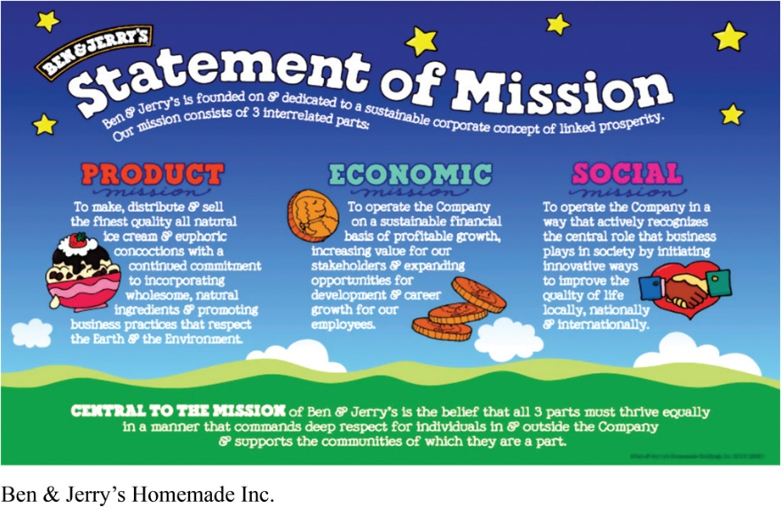
The Political-Social and Cultural Environments (2 of 5)
The Political and Social Environment
Increased emphasis on ethics and socially responsible actions
Cause-related marketing
Cause-related marketing: Ben & Jerry’s three-part “linked prosperity” mission drives it to make fantastic ice cream (product mission), manage the company for sustainable financial growth (economic mission), and use the company “in innovative ways to make the world a better place” (social mission). Both Ben & Jerry’s and its products are “Made of Something Better.”
Notes:
Written regulations cannot possibly cover all potential marketing abuses, and existing laws are often difficult to enforce. However, beyond written laws and regulations, business is also governed by social codes and rules of professional ethics.
Enlightened companies encourage their managers to look beyond what the regulatory system allows and simply “do the right thing.”
To exercise their social responsibility and build more positive images, many companies are now linking themselves to worthwhile causes. It has become a primary form of corporate giving which lets companies “do well by doing good” by linking purchases of the company’s products or services with benefiting worthwhile causes or charitable organizations.
Cause-related marketing has stirred some controversy. Critics worry that cause-related marketing is more a strategy for selling than a strategy for giving—that “cause-related” marketing is really “cause-exploitative” marketing.
Long Description:
The details of the poster are as follows:
The statement of mission reads "Ben and Jerry's are founded on and dedicated to a sustainable corporate concept of linked prosperity."
The mission includes three parts such as product, economic, and social as follows:
Product mission: To make, distribute and sell the finest quality all natural ice cream and euphoric concoctions with a continued commitment to incorporating wholesome, natural ingredients and promoting business practices that respect the Earth and the Environment.
Economic mission: To operate the Company on a sustainable financial basis of profitable growth, increasing value for our stakeholders and expanding opportunities for development and career growth for our employees.
Social mission: To operate the Company in a way that actively recognizes the central role that business plays in society by initiating innovative ways to improve the quality of life locally, nationally and internationally.
The bottom of the poster reads "Central to the mission of Ben and Jerry's is the belief that all 3 parts most thrive equally in a manner that commands deep respect for individuals in and outside the Company and supports the communities of which they are a part."

Slide 32
The Political-Social and Cultural Environments (3 of 5)
The Cultural Environment
The cultural environment consists of institutions and other forces that affect a society’s basic values, perceptions, and behaviors.
Notes:
Cultural factors strongly affect how people think and how they consume, so marketers are keenly interested in cultural forces.

Slide 33
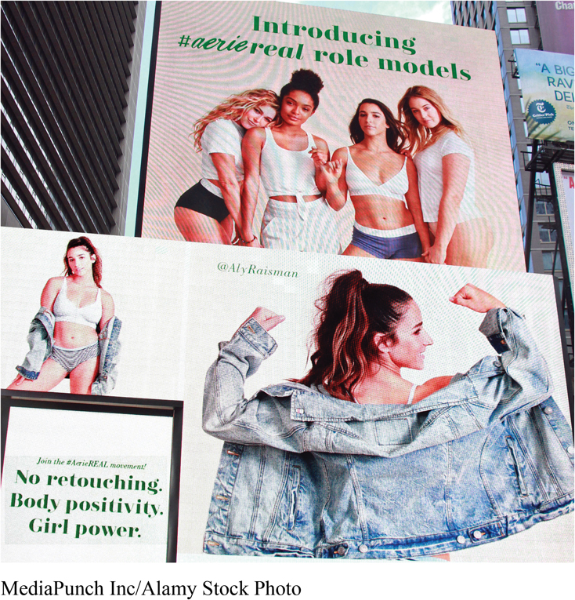
Cause-Related Marketing: Linking Brands, Consumers, and Causes
Aerie’s #AerieREAL campaign pledges that it will use only unretouched images and videos of real women in its ads and other marketing content. The cause of body positivity and inclusivity is an integral part of the brand’s identity.
Notes:
Cause-related marketing goes far beyond retailers. It seems that almost every brand supports some cause. Good cause-related marketing programs strategically link brands, causes, and consumers in authentic and meaningful ways.
Long Description:
The advertisement shows a billboard depicting two photos of models.
The first photo shows four models posing together in lingerie and loungewear; the corresponding text reads "Introducing hashtag aerie real role models."
The second photo shows a model in lingerie but loosely wearing a denim shirt over it and flexing her arms; the corresponding text reads "Join the hashtag Aerie Real movement! No retouching. Body positivity. Girl power."

Slide 34
The Political-Social and Cultural Environments (4 of 5)
The Cultural Environment
Core beliefs and values are persistent and are passed on from parents to children and are reinforced by schools, churches, businesses, and government.
Secondary beliefs and values are more open to change and include people’s views of themselves, others, organizations, society, nature, and the universe.
Notes:
The cultural environment consists of institutions and other forces that affect a society’s basic values, perceptions, preferences, and behaviors. People grow up in a particular society that shapes their basic beliefs and values. They absorb a worldview that defines their relationships with others. Cultural characteristics can affect marketing decision making.
People in a given society hold many beliefs and values. Their core beliefs and values have a high degree of persistence. For example, most Americans believe in individual freedom, hard work, getting married, and achievement and success. These beliefs shape more specific attitudes and behaviors found in everyday life.
Secondary beliefs and values are more open to change. Believing in marriage is a core belief; believing that people should get married early in life is a secondary belief. Marketers have some chance of changing secondary values but little chance of changing core values.

Slide 35

The Political-Social and Cultural Environments (5 of 5)
The Cultural Environment
Catering to the natural, organic, and ethical products trend: Unilever’s Love Beauty and Planet brand has one goal: “To make you more beautiful and give a little love to our planet.”
Shifts in Secondary Cultural Values
People’s views of themselves
People’s views of others
People’s views of organizations
People’s views of society
People’s views of nature
People’s views of the universe
Notes:
Core values are fairly persistent, but cultural swings take place. People vary in their emphasis on serving themselves vs. serving others. People’s attitudes toward and interactions with others shift. People vary in their attitudes toward corporations, government agencies, trade unions, universities, and other organizations. People vary in their attitudes toward their societies – they may be patriots, reformers, malcontents. People vary in their attitudes toward the natural world – they may feel ruled by it, in harmony with it, or want to master it. People also vary in their beliefs about the origins of the universe and their place in it.
Long Description:
The advertisement shows a woman holding a product of Love Beauty and Planet. The corresponding text reads "New Love beauty and planet; make a vegan beauty resolution you'll love to keep; small acts of love in every bottle: we love fabulous formulas, we love 100 percent recycled bottles, we love ethical essential oils, we love no parabens or colorants." The bottom left corner shows three products of the brand and the bottom right corner shows a vegan label with a text below that reads "Now available at Sainsbury's, Boots, Superdrug and Tesco."

Slide 36
Learning Objective 5
Discuss how companies can react to the marketing environment.

Slide 37
Responding to the Marketing Environment
Views on Responding
Uncontrollable
React and adapt to forces in the environment
Proactive
Take aggressive actions to affect forces in the environment
Reactive
Watch and react to forces in the environment
Notes:
Someone once observed, “There are three kinds of companies: those who make things happen, those who watch things happen, and those who wonder what’s happened.”
Many companies view the marketing environment as an uncontrollable element. They passively accept the marketing environment, analyze environmental forces, and design strategies that will help the company avoid the threats and take advantage of the opportunities the environment provides.
Other companies take a proactive stance toward the marketing environment. Rather than assuming that strategic options are bounded by the current environment, these firms develop strategies to change the environment and overcome seemingly uncontrollable environmental events.
“Business history . . . reveals plenty of cases in which firms’ strategies shape industry structure,” says the expert, “from Ford’s Model T to Nintendo’s Wii.”
Marketing management cannot always control environmental forces. In many cases, it must settle for simply watching and reacting to the environment. But whenever possible, smart marketing managers take a proactive rather than a reactive approach to the marketing environment.

Slide 38

Real Marketing 3.2: In the Social Media Age: When the Dialogue Gets Nasty
Today’s empowered consumers: Whole Foods Market’s decision to put single pre-peeled oranges in individual plastic containers caused a viral storm of #OrangeGate tweets. However, the retailer averted the potential PR disaster by responding within hours with its own humorous, self-critical social media posts admitting its mistake.
Notes:
Marketers have hailed the internet and social media as a great way to engage customers and nurture customer relationships, but the dialogue between customers about their brand experiences can get nasty.

Slide 39

Copyright
This work is protected by United States copyright laws and is provided solely for the use of instructors in teaching their courses and assessing student learning. Dissemination or sale of any part of this work (including on the World Wide Web) will destroy the integrity of the work and is not permitted. The work and materials from it should never be made available to students except by instructors using the accompanying text in their classes. All recipients of this work are expected to abide by these restrictions and to honor the intended pedagogical purposes and the needs of other instructors who rely on these materials.

